Slide 1
Using Your PSAT™ 8/9 Scores to Prepare for College
A Lesson Plan to Use With Students
MCMS PSAT Score Interpretation Night

Slide 2
8th Grade Students at Missouri City Middle School took the PSAT Exam on Wednesday, October 13, 2021.

Slide 3
Using Your PSATTM 8/9 Scores to Prepare for College

Slide 4
What Are the Benefits of Taking the PSAT™ 8/9?
Get a baseline of your college readiness.
Prepare for the PSAT/NMSQT® and SAT®.
Get free, personalized, and focused practice through Khan Academy®.
Start getting ready for college with college and career planning tools.
See the AP® courses for which you might be ready.
Notes:
The PSAT 8/9 is a preview of the content on the SAT and the PSAT/NMSQT, and can help them practice for both assessments. PSAT 8/9 scores, and all scores in the SAT Suite of Assessments, are accessible from the student’s online College Board account. In addition, the PSAT 8/9 offers other benefits.
1. If students link their College Board account with their Khan Academy® account, Khan Academy will use the PSAT 8/9 scores to design a practice plan and practice questions tailored to each student’s strengths and areas for improvement. This program is completely free, and practice test questions on Khan Academy are created with College Board approval, so this is the best SAT practice available.
2. The student’s online score report links to valuable tools for college and career planning. Students can use BigFuture™ and Roadmap to Careers to investigate their academic interests, colleges, and career options (more about BigFuture and Roadmap to Careers at the end of the lesson, slides 29-30).
3. PSAT 8/9 scores are indicators of ability to succeed in two Advanced Placement® courses (for ninth-grade students). Students can find the AP® courses in which they are likely to succeed in the online reporting system (more information about the online reporting portal begins on slide 8).
4. If students opt in to Student Search Service® , they will begin to receive information about admission and financial aid from colleges that also participate in the program.

Slide 5
Understanding My Paper Score Report
Notes:
This section provides a review of the paper score report that students receive from the school.

Slide 6
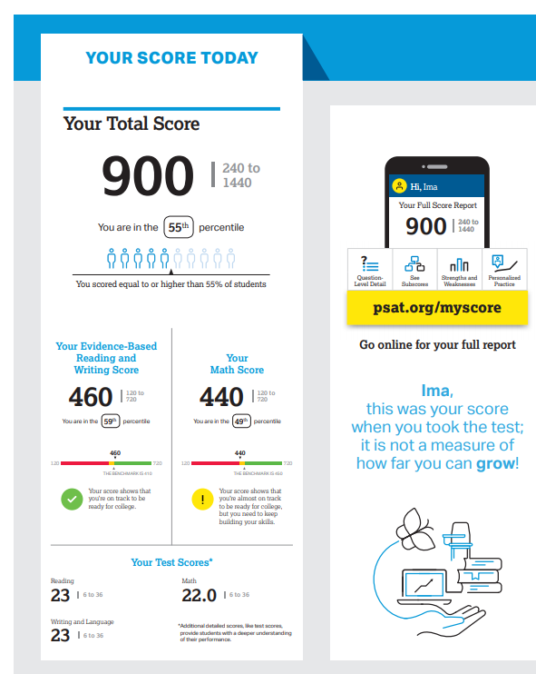
What Are My Scores?
Scores for the assessments in the SAT® Suite are vertically equated.
Notes:
Ask students to find “Your Total Score” in the center of the score report. Total scores are based on a scale of 240 to 1440 on the PSAT 8/9. Inform students that this is the score they would likely receive on the SAT had they taken the SAT on the same day they took the PSAT 8/9. The SAT total score ranges from 400 to 1600. Ask students to consider whether they would be satisfied with this SAT score if they are were using it to apply for college.
Beneath “Your Total Score,” students will find their section scores. “Your Evidence-Based Reading and Writing Score” is on the left (460 on the slide), and is the scaled score they earned from the Reading Test and the Writing and Language Test combined. “Your Math Score,” to the right of the total score (440 on the slide), is the scaled score they earned from taking the Math Test. Both of these section scores are on a scale of 120 to 720 on PSAT 8/9, and are added together to get the total score. On SAT, the range for these section scores is 200 to 800.
Below the Evidence-Based Reading and Writing Score, and below the Math Score, students will see where their scores fell on a graph between 120 and 720. The colors on this graph represent the grade-level benchmark. Students who meet the grade-level benchmark are on track to meeting the college and career readiness benchmark in the same subject on the SAT. Students to meet the college and career readiness benchmark on the SAT have a 75 percent likelihood of earning a C or better in an entry-level college course in the same subject area. For their section scores, if the score falls in the red area of the graphic, they “need to strengthen their skills,” meaning they are more than one year below the grade-level benchmark. If the score falls in the yellow part of the graphic, they are “approaching benchmark,” or below the grade-level benchmark by one year or less. If the score falls in the green area of the graphic, they have met or exceeded the benchmark.

Slide 7
What Are My Score Percentiles?
Percentiles and benchmarks are provided for eighth and ninth grades on the PSAT/NMSQT®.
Notes:
Immediately under each of the three scores, students are presented with their Nationally Representative Sample Percentile. This number is the percentile ranking for a student if ALL U.S. students, in their same grade, took the test. (It is a norm-referenced group of all U.S. students in their grade, regardless of whether they typically take the PSAT 8/9, derived via a weighted research study sample.) From the example on the slide, the student can read that, at the score of 900, he or she performed better than 55 percent of students nationally. Help students find and understand their Nationally Representative Sample Percentile for both section scores and the total score.
Percentiles and benchmarks are provided for eighth and ninth grades on the PSAT 8/9. If a student is a grade ahead or behind, then he or she is compared to the nearest grade level. For example a seventh-grader will be compared to eighth-grade benchmarks.

Slide 8
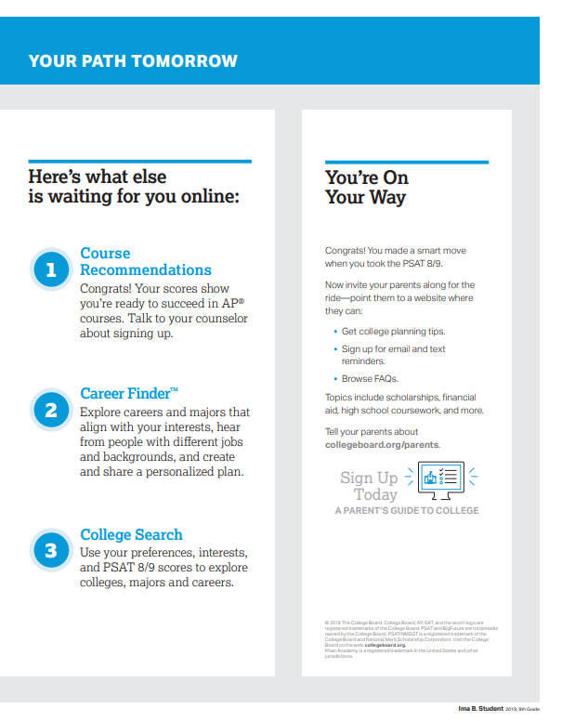
What Can I Do To Prepare For My Future?
Notes:
The third page of the report encourages students to go to their online report where they can find Advanced Placement course recommendations (9th grade only), career search tools through Career Finder (more on slide 30), and college search information using BigFuture (more on slide 29). In their online score reports, students can also look at their detailed scores, Skills Insight, and test questions (on disclosed forms).

Slide 9
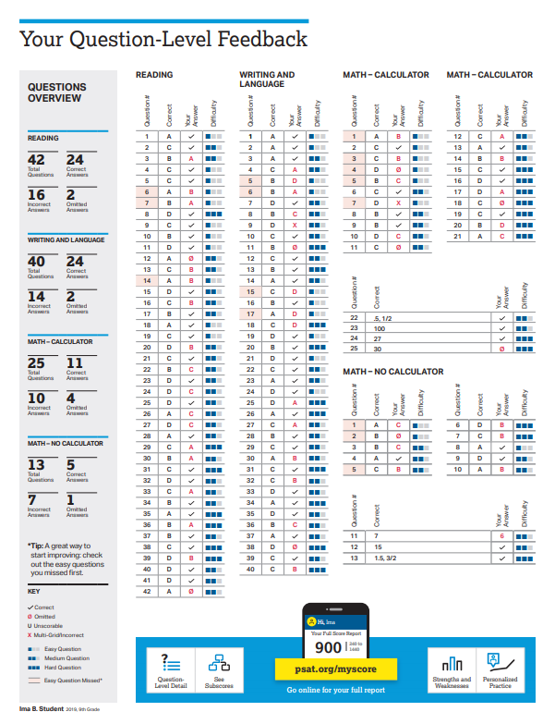
What Is My Question-Level Feedback?
Notes:
Question-level feedback allows students to understand how many and which questions they answered correctly, incorrectly, and omitted. The last page of the report explains the total number of questions for each test, the number of correct and incorrect answers the student chose, and the number of omitted answers. If students have many omitted answers, remind them that there is no penalty for guessing and they should give their best answer for each question.
The difficulty level of each question is also provided. Questions are reported as easy, medium, and hard; this level is determined by the College Board based on overall performance for each question. Students can see which easy questions they missed by looking for questions shaded in beige. If students have taken a disclosed form of the assessment, they can access their scores online and read the actual text of the questions and get answer explanations.
Ask students to write down the areas in which they can improve their skills (from the right side of the score), and then think about and commit to ways to work on those skills. Their plans might include practicing on Official SAT Practice on Khan Academy or asking for help from a teacher. It might be assignments that teachers provide in their classes. It is helpful for the students to develop plans for skill development as they review their scores with their teachers.

Slide 10
What Are My Next Steps?
Continue to take challenging courses in high school
Link scores with Official SAT Practice on Khan Academy®
Set up a practice plan and stick to it
Utilize other resources to research and prepare for college
Notes:
Upcoming slides will explain Official SAT Practice with Khan Academy, BigFuture, Roadmap to Careers, and Student Search Service.

Slide 11
Official SAT® Practice on Khan Academy®— It’s FREE!
Go to satpractice.org and create a free account.
Get personalized recommendations. Link your Khan Academy account to your College Board account to import past SAT Suite results or take diagnostic quizzes to get personalized recommendations.
Create a study plan. Select a test date and set up a practice schedule.
Notes:
Official SAT Practice on Khan Academy is offered to students at no cost. Students have access to thousands of official SAT test questions (written and reviewed by the College Board) and ten full-length SAT tests. Students can access Official SAT Practice on a computer, or by using the Daily SAT Practice app or Khan Academy app on their mobile device. Khan Academy creates personalized learning plans for each student based on his or her test performance and practice on Khan Academy. It also provides videos that will tutor students in the areas in which they need help.

Slide 12
How Can I Practice with Khan Academy®?
Watch a video introducing Official SAT Practice on Khan Academy.
Thousands of practice questions and videos covering every SAT® concept
Six official, full-length SAT practice tests with more to come
Personalized recommendations based on each student’s strengths and weaknesses
Tailored practice schedule mapping out each students’ path to test day
SAT tips and strategies, sharing information about each part of the test
Notes:
This slide links to a video that demonstrates the features of Official SAT Practice on Khan Academy. Students in a computer lab setting can set up their accounts immediately. They have to enter their name, email address, and birth date, and will immediately receive a link to set up a username and password. They can also use their Gmail or Facebook login information to get started immediately. They can then log in to the account and begin practicing.

Slide 13
What Steps Will I Follow to Link My College Board Account to Khan Academy®?
Step 1
Log in or create a Khan Academy account.
Step 2
When prompted, agree to link your Khan Academy and College Board accounts. You will then be directed to collegeboard.org.
Step 3
Sign in or create a College Board Account.
Step 4
When prompted, hit “Send” to authorize the account linking.
Step 5
Start practicing on Official SAT® Practice on Khan Academy!
Notes:
In order to receive personalized practice plans based on their PSAT 8/9 results, students will have to link their Khan Academy accounts and their College Board accounts. To begin the linking process, students must log in to their Khan Academy accounts. Students will be prompted to link their Khan Academy and College Board accounts when they log in. When students agree to link the accounts, they will be directed to collegeboard.org. When they reach collegeboard.org, they will need to sign in to their College Board account.

Slide 14
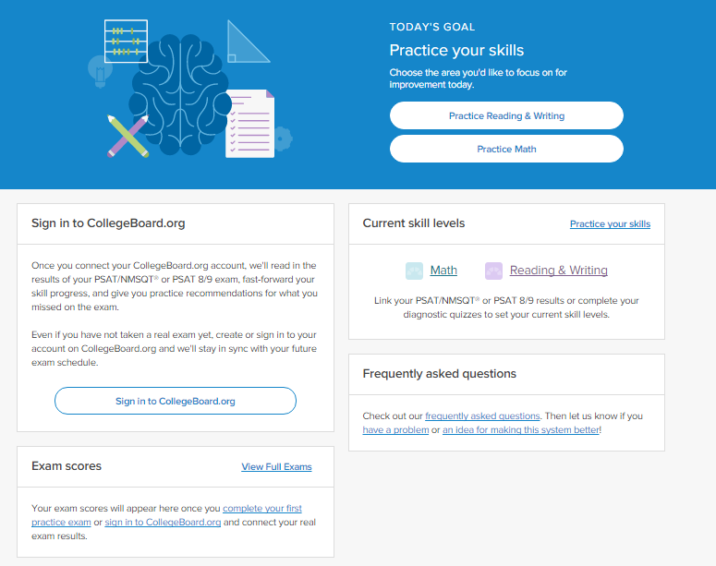
How can I Link My College Board and Khan Academy® Accounts?
After successfully logging in to your College Board account, you will be asked to authorize the account linking.
After clicking “Send,” you will be redirected to Official SAT® Practice on the Khan Academy site.
You can remove the link at any time by clicking on “Revoke,” which is found in your College Board account settings.
Notes:
After successfully logging in to the College Board account, they will be asked to authorize the linking of the accounts. This allows Khan Academy to access student score data related to the SAT Suite of Assessments. Students will see a screen clarifying what they are agreeing to link. If they choose to click “Send,” they will be directed back to SAT practice on Khan Academy. Students can choose to remove the link by clicking on “Revoke” in the College Board account settings.

Slide 15
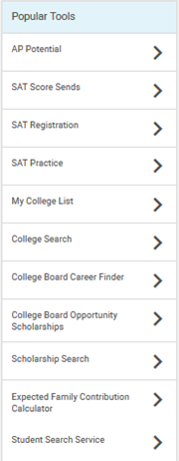
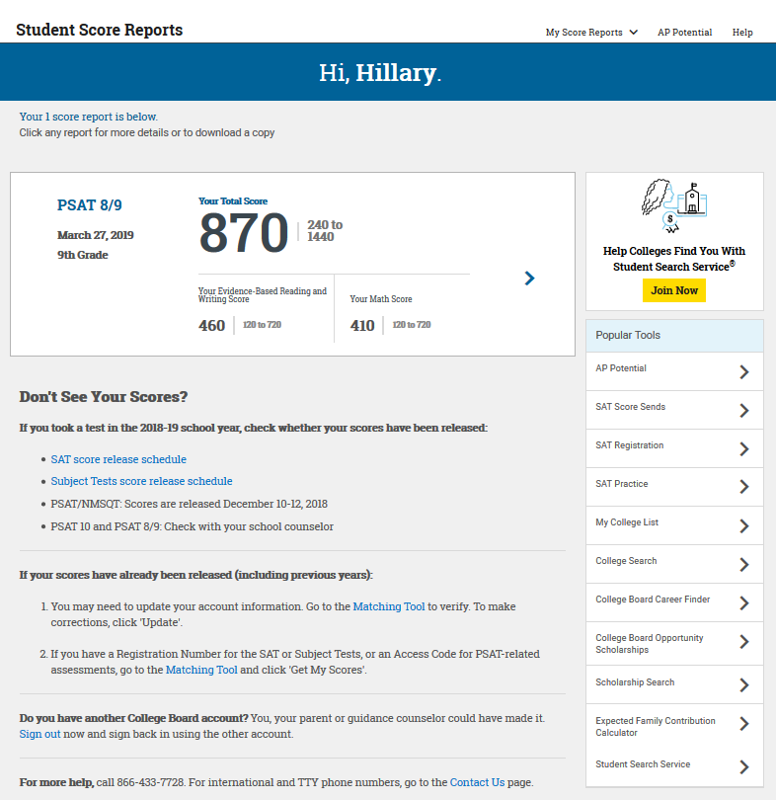
What Additional Resources Will Help Me Prepare for My Future?
BigFuture™
College Action Plan
College Search
Scholarships
Financial Aid
Roadmap to Careers
Student Search Service®
Notes:
Students have multiple resources available to help them plan and prepare for college. The Popular Tools menu includes links to other College Board tools within BigFuture™ and Career Finder™ .
The College Board developed BigFuture in collaboration with parents, students, and educators to make the college planning process easier and less overwhelming. At bigfuture.org, students can:
› Use intelligent search-and-match tools and informative videos to find colleges that are a good fit.
› Learn how families have paid for college.
› Create a personalized plan for college so students know what to do and when to do it.
Career Finder provides a career exploration tool that can help students learn more about their interests and how this may correspond to a future career.
Student Search Service (slide 31) connects colleges with potential students.

Slide 16
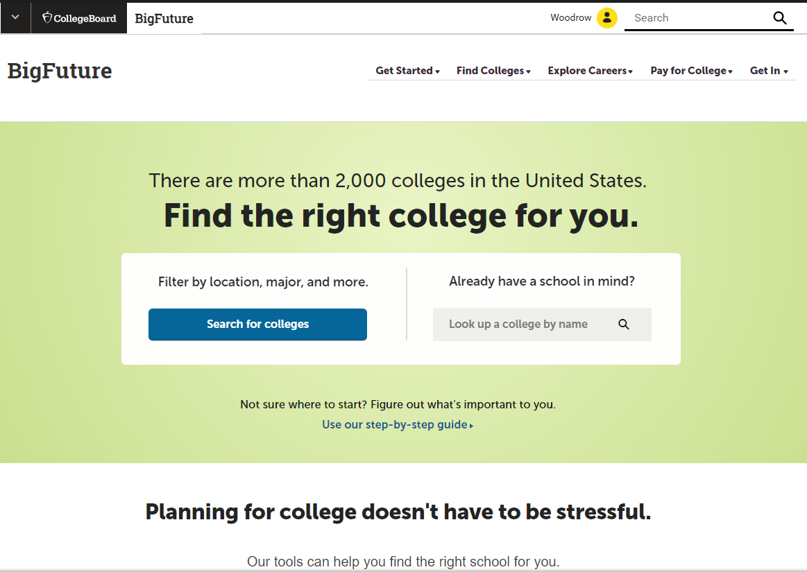
BigFuture™— Search Colleges, Scholarships, and Careers
Search for colleges.
Watch videos from real students.
Hear from education professionals.
Learn about different colleges.
Get help paying for college.
Build a personalized plan for getting into college.
Notes:
BigFuture is the website that helps students plan for college. It is a free, comprehensive website that guides students as they prepare for, find, and enroll in college. At bigfuture.org, students can:
Start with a focus on themselves: their interests, what and where they want to study, how much financial assistance they think they’ll need, and other important considerations.
Search for colleges and easily compare them based on factors ranging from majors to size and location.
Watch videos from real students who explain what they did to get into college and what their college experiences have been like.
Hear from education professionals who provide the inside story on preparing for and getting into college.
Learn about the different kinds of colleges and how to find one that is the right fit for them.
Find valuable help in paying for college by discovering what goes into college costs and how to find financing.
Build a personalized plan for realizing their goals and getting into a college that meets their needs.

Slide 17
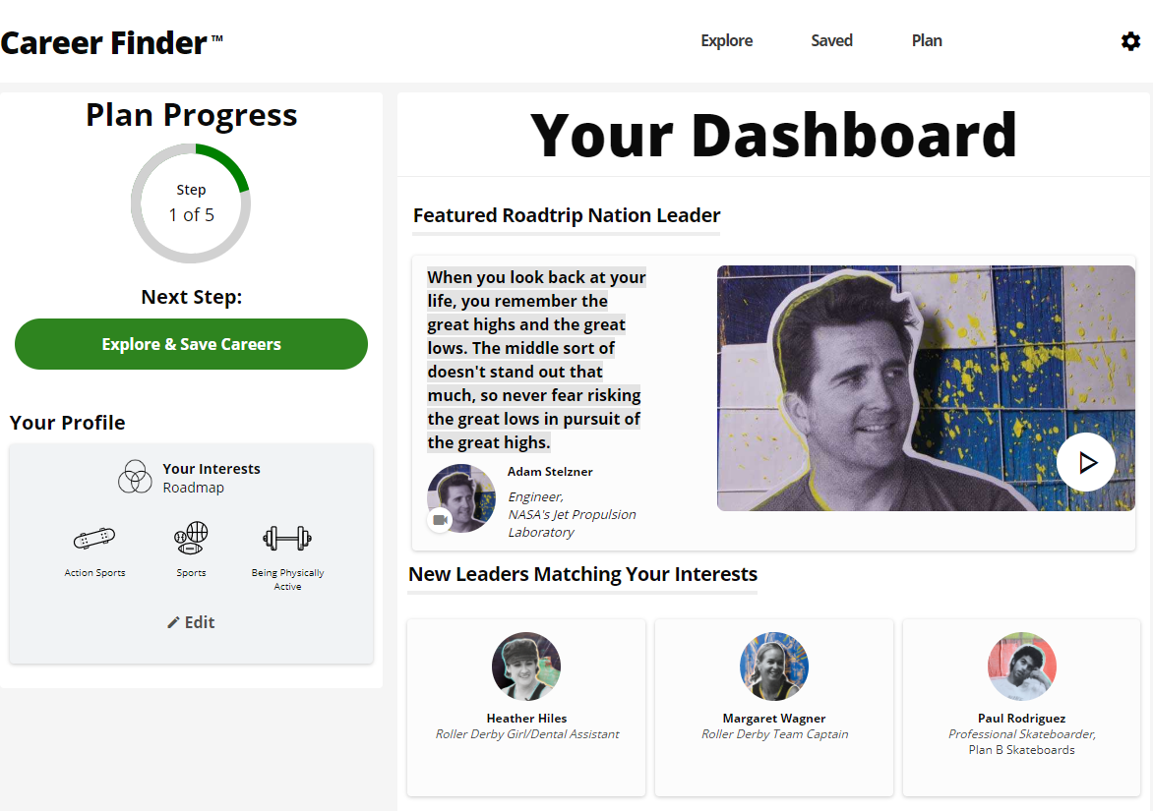
Career Finder
Roadtrip Nation and College Board are partnering to help students connect with careers.
Choose your core interests.
Watch videos of leaders who share your interests.
Learn about majors and careers that align to your interests.
See examples of leaders who followed a similar path.
Notes:
Roadtrip Nation can then blend all of those together to create a personalized journey for students through people, careers, and majors that align with their interests. It starts by looking at Leaders who match their interests. They might be famous people, or the glass blower down the street who loves her job. Students watch videos of these Leaders talking about their path, and they can see what education and path the Leaders followed. Students learn about majors that align to their interests, get tangible recommendations for ways to be ready for this major (through coursework and otherwise), and see examples of Leaders who have followed a similar path. Finally, students can learn more directly about careers that align with their interests so that they know why it’s worth putting in the effort in their high school classes and worth going to college.

Slide 18
Student Search Service®
Connects students with information about educational and financial aid opportunities.
Participate voluntarily.
Connect with more than 1,200 colleges, universities, scholarship programs, and educational organizations.
Sign up when you take an assessment in the SAT® Suite:
Choose to participate in Student Search Service when registering for a College Board test (fill in the circle on the answer sheet).
Provide information about yourself on your answer sheet.
Participating organizations can then search for groups of students who may be a good fit.
FYI: The College Board never shares information on disabilities, parental education, self-reported parental income, Social Security numbers, phone numbers, or actual test scores through Student Search Service.
Notes:
Student Search Service is a voluntary program that connects students with information about educational and financial aid opportunities from more than 1,200 colleges, universities, scholarship programs, and educational organizations. Here’s how it works:
› Students may choose to participate in Student Search Service when registering for a College Board test.
› As part of taking the PSAT 8/9, students are asked to provide information about themselves on their answer sheet.
› Participating, eligible organizations can then search for groups of students who may be a good fit for their communities and programs, but only among those students who opt to participate in Student Search Service.
› The search criteria can include any attribute from the answer sheet; however, information on disabilities, parental education, self-reported parental income, Social Security numbers, phone numbers, and actual test scores are not shared. The most searched items are expected high school graduation date, cumulative grade point average (GPA), and intended college major. If students have questions or concerns about Student Search Service or want more information about the program, please tell them to go to collegeboard.org/student-search-service or to call 866-825-8051.
Here are some points to keep in mind about Student Search Service:
» Colleges participating in Student Search Service never receive student scores or phone numbers. Colleges can ask for names of students within certain score ranges, but exact scores are not reported.
» Being contacted by a college doesn’t mean you have been admitted. You must submit an application in order to be considered for admission. The colleges and organizations that participate want to find students who will fit their environment, classes, programs, scholarships, and special activities. Student Search Service is simply a way for colleges to reach prospective students like you and to let them know about the opportunities that are available.
» Student Search Service will share your contact information only with colleges and qualified nonprofit educational or scholarship programs that are recruiting students like you. Your name will never be sold to a commercial marketing firm or a retailer of merchandise or services (such as test prep). Student Search Service communications are sent by outside colleges, scholarship programs, and educational opportunity organizations

Slide 19
Thank You.

